Slide 1
ULMFiT for Text Classification Jeremy Howard and Sebastian Ruder https://arxiv.org/abs/1801.06146
Presented by:
Shadman Shoumik (45563659)
Shivani Kukreti (45666547)
Suchith Kumar Suresh (45502897)

Slide 2
INTRODUCTION
This research paper uses Transfer Learning that can be applied to any task in NLP.
It introduces a key for fine-tuning a language model.
The significant outcomes of this research reduced the error by 18-24% on the majority of the datasets.

Slide 3
INDICATOR OF QUALITY
The ULMFiT model as used in the paper achieved the highest accuracy of 95.4% in the IMDB sentiment analysis surpassing the state-of-the-art results which were available at the time this paper was published in 2018.
In just over a year, this paper has 297 citations.
The only models which have been able to beat this accuracy are Bert and XLNet which came out just this year.
ULMFiT uses transfer learning and deep learning which we believe is a very upcoming field in NLP.

Slide 4
FEASIBILITY OF THE PROJECT
Is the code accessible?
https://paperswithcode.com/paper/universal-language-model-fine-tuning-for-text
Does it look likely to be able to be successfully implemented?
Have run the code in Colab and it ran successfully.
Is the original data actually available?
The original IMDb data is available at http://ai.stanford.edu/~amaas/data/sentiment/

Slide 5
Original Data
Using Fast.ai to replicate the code in the research paper which is a Python library containing some popular algorithms for image classification and natural language tasks
Uses pre-trained word embeddings (hypercolumns)
Classification type: Sentiment Analysis
Using the IMDb large movie review dataset containing 25,000 observations with 3 variables (label, text, is_valid)

Slide 6
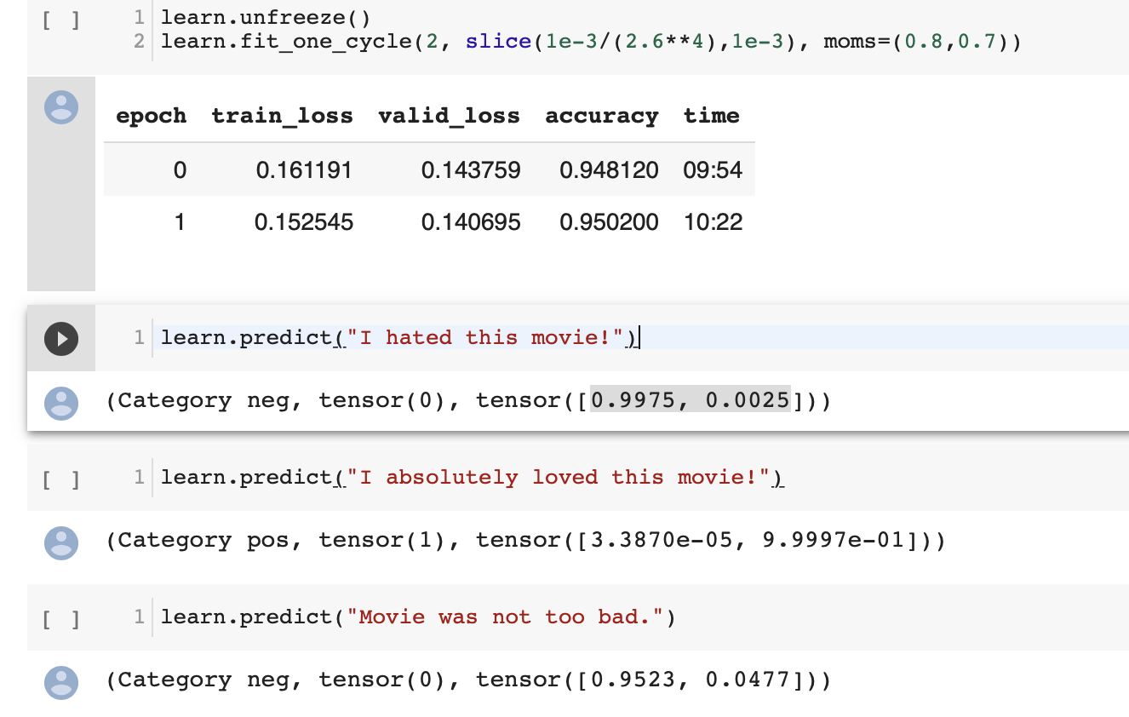
Replication on Original DATa
We were able to replicate the code on the original IMDB dataset successfully.
It took about 14 hours to run the code on Colab GPU.
As the GPU training and instances were expensive on AWS, we decided to run this code on Colab as it is a credit-free platform.

Slide 7
NEW DATA
Data-sets containing reviews from different domains like:
Amazon Reviews
Coursera Reviews
Drug Reviews

Slide 8
amazon REVIEW
Source Dataset: https://s3.amazonaws.com/fast-ai-nlp/amazon_review_polarity_csv.tgz
I will be using Amazon review dataset containing 2 million reviews which include product and user information, ratings and a plaintext review.
Will be using 50,000 samples to read and replicate the code on this dataset.
Data is been preprocessed with removing the null values and Tokenizing the dataset.

Slide 9
Coursera Reviews
Source: https://www.kaggle.com/septa97/100k-courseras-course-reviews-dataset
The coursera course review dataset contains 100k labelled reviews for the coursera courses.
The data is split into training st (70%) and testing set (30%) with dataset variable of courseID, review and label.
The dataset is been preprocessed, containing some other language inputs in the reviews section which are removed. And using only Language English reviews.

Slide 10
Drug Reviews
Soure Dataset: https://archive.ics.uci.edu/ml/machine-learning-databases/00462/drugsCom_raw.zip
The dataset provides patient reviews on specific drugs along with related conditions and rating reflecting overall patient satisfaction.
The data is split into a train (75%) and test (25%) partition with 200 thousand observation and replicate the code on this dataset.
Attributes contains : drugName , condition ,review and rating.
Data is been pre-processed by removing the Stopwords and based on sentiment score labelling the polarity (2 for positive, 1 for negative, 0 for neutral).

Slide 11
THANK YOU

